Slide 1


CS140 – Computer Programming 1 Course Overview
First Semester – Fall 2017
1438/1439 – 2017/2018

Slide 2
Outline
Course Information
Course Description
Course Requirements
Course Objectives
Topics & Assessment
The Programming Environment

Slide 3
Course Information
Credit Hours
4 credit hours
Regular Lecture: 2 h, Tutorial: 2 h, and Laboratory: 2 h
Instructor
Name:
Email:
Textbook
Java: How to Program (Late Objects Version), Global Edition, 10th Edition, Paul Deitel and Harvey Deitel, Pearson, 2015

Slide 4
Course Description
“The course introduces students to structured programming techniques.
Topics include different control statements (sequence, selection, and repetition), functions, fundamental data types, and data structures (arrays).
Upon successful completion of the course, students will solve computer problems by using structured programming techniques and adequate tools (text editor, compiler, and debugger).”

Slide 5
Course Requirements
No Prerequisite course (level 1)
Acquired mathematical knowledge
Acquired (preliminary) problem solving knowledge (preparatory year)

Slide 6
Course Objectives
To develop problem solving and programming skills to enable the student to design solutions to nontrivial problems and implement those solutions in Java.
To master the fundamental programming constructs of Java language, including variables, strings, expressions, methods, and control structures.
To build a foundation for more advanced programming constructs and fundamental data structures in Java language, including recursive functions, arrays, enumerations, and files.
To gain experience in the basic software development methods and tools, including modern programming environments, code review, testing fundamentals, debugging strategies, documentation and program style.

Slide 7
Course Topics
List of Topics | No. of Weeks | Contact Hours
Welcome & Course Overview Introduction to Computer Programing and Java | 1 | 6
Fundamentals of Java Programs Input/Output, Variables, and Arithmetic | 2 | 12
Introduction to Problem Solving Selection Control Statements & Logical Operators | 3 | 18
Formulating Algorithms, Repetition Control Statements | 3 | 18
Methods Introduction to Recursion | 2 | 12
Primitive Types Vs. Reference Types Strings, enumerations | 1 | 6
Arrays Introduction to Searching | 2 | 12
Files: reading, writing, and updating. | 1 | 6

Slide 8
Assessment
Homework Assignments will be provided every week (not graded)
Assessment | Assessment Task | Week Due | Proportion of Total Assessment
1 | Lab Exams: 1, 2, & 3 | 6, 10, & 14 | 30 (3 * 10 marks)
2 | Midterm Exams: 1 & 2 | 8 & 12 | 30 (2 * 15 marks)
3 | Final Exam | 16 | 40

Slide 9
Week # | Tutorials | Assignments | Assessment (Graded)
1
2 |  | Lab Work 00
3 | Tutorial 01 | Homework 01 & 02 + Lab Work 01
4 | Tutorial 02 & 03 | Homework 03 + Lab Work 02
5 | Tutorial 04 | Homework 04 + Lab Work 03
6 | Tutorial 05 | Homework 05 | Lab Exam 1
7 | Tutorial 06 | Homework 06 + Lab Work 04
8 |  | Homework 07 + Lab Work 05 | Midterm exam 1
Break
9 | Tutorial 07 | Lab Work 06
10 | Tutorial 08 | Homework 08 | Lab exam 2
11 | Tutorial 09 | Homework 09 + Lab Work 07
12 |  | Homework 10 + Lab Work 08 | Midterm exam 2
13 | Tutorial 10 | Lab Work 09
14 | Tutorial 11 | Homework 11 | Lab exam 3
15 |  | Lab Work 10

Slide 10
Preparing the Programming Environment
Installing Netbeans along with the JDK
http://www.oracle.com/technetwork/java/javase/downloads/index.html
Temporarily, you can use online compiler (not recommended):
https://www.tutorialspoint.com/compile_java_online.php

Slide 11
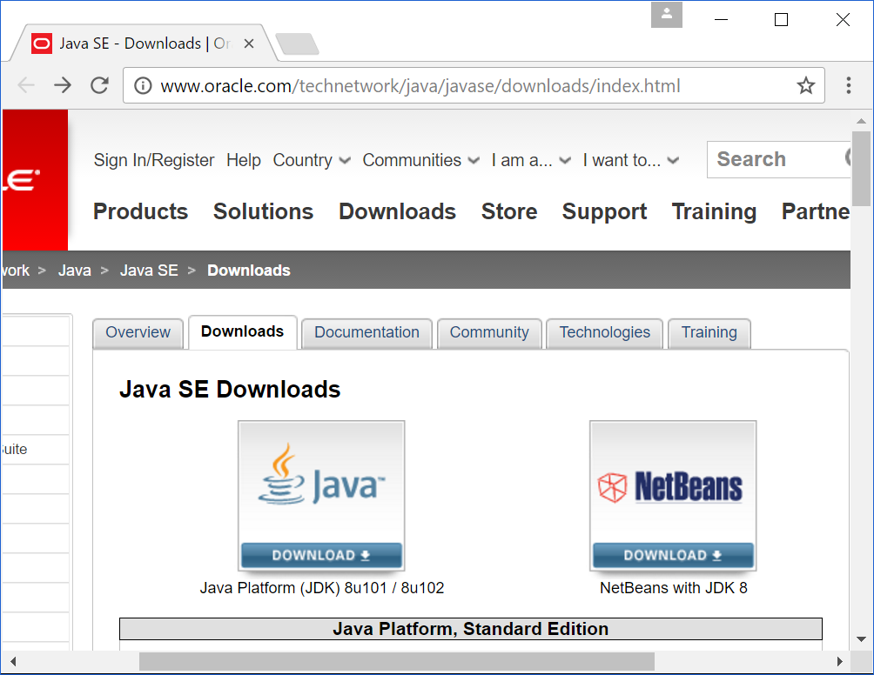

1

Slide 12
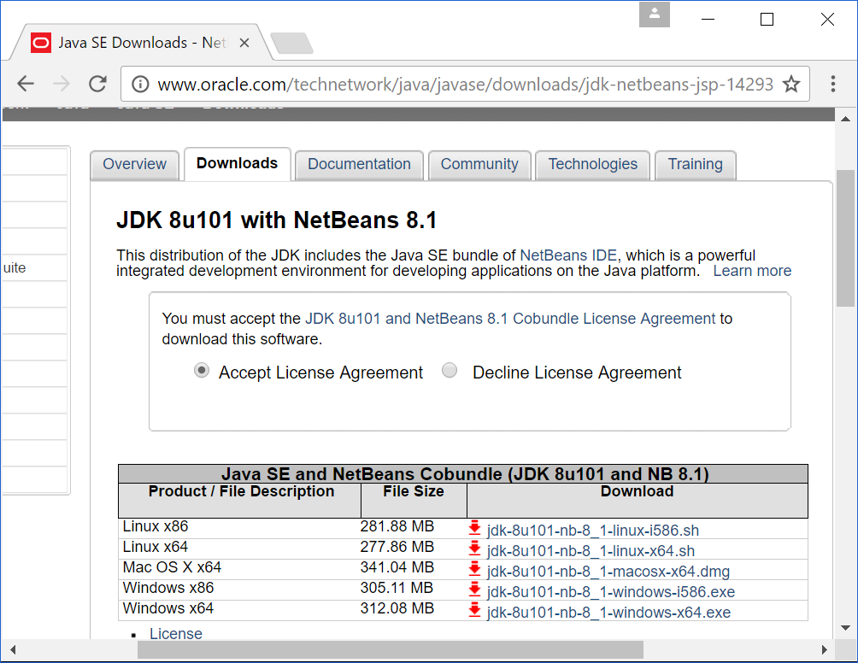
2
3

Slide 13
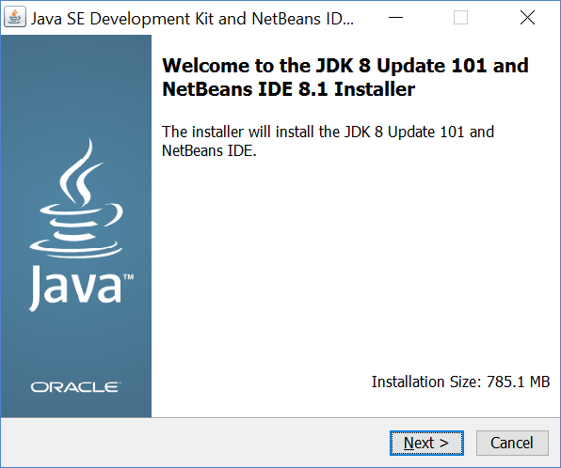
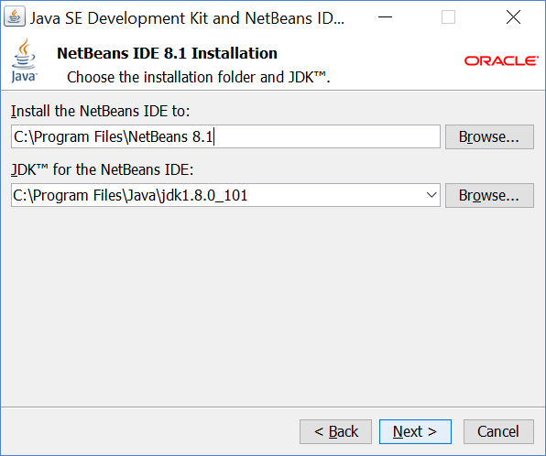
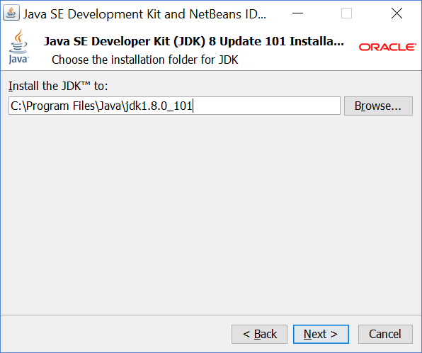
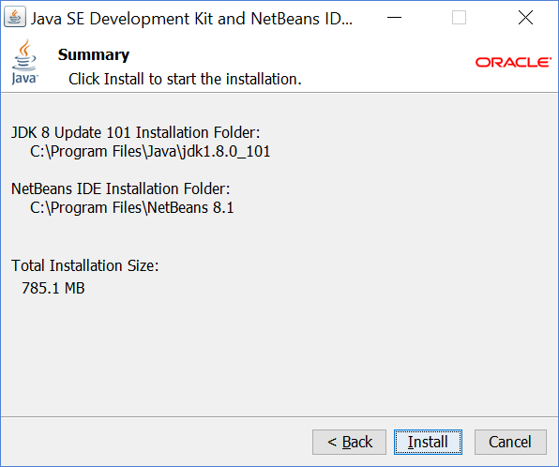
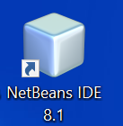
4
5
7
9
6
8

